Slide 1

DEPARTMENT OF ARTIFICIAL INTELLIGENCE AND DATA SCIENCE ACADEMIC YEAR 2025 - 2026 SEMESTER III ARTIFICIAL INTELLIGENCE LABORATORY MINI PROJECT REVIEW ROCK, PAPER, SCISSOR GAME USING MONTE CARLO SEARCH
REGISTER NUMBER | 2117240070051
NAME | Deepika C
YEAR | II
SECTION | A
FACULTY IN-CHARGE | Mrs. M. Divya

Slide 2
PROBLEM STATEMENT
The problem is to assign a color to each region on a map such that no two regions sharing a common border are assigned the same color. The core challenge is to achieve this using a predefined, and often minimal, number of colors.
This can be formally defined as a Constraint Satisfaction Problem (CSP) with the following components:
Variables: Each region of the map.
Domain: The set of available colors that can be assigned to each region.
Constraints: If two regions are adjacent (share a border), they cannot be assigned the same color.
The application's task is to find a valid assignment of colors to all regions that satisfies all constraints for a given number of colors.

Slide 3
THEORETICAL BACKGROUND
The solution is built upon several key computer science concepts:
Graph Theory: A map is abstractly represented as a graph. Each region becomes a node (or vertex), and an edge is drawn between two nodes if their corresponding regions share a border. The map coloring problem is thus transformed into a graph coloring problem.
Constraint Satisfaction Problem (CSP): As previously stated, the problem fits the CSP framework perfectly. The algorithm's job is to find a complete and consistent assignment for all variables.
Backtracking Algorithm: This is a depth-first search algorithm used for solving CSPs. It works by incrementally building a solution and abandoning a path (i.e., "backtracking") as soon as it determines that the path cannot lead to a valid solution. This avoids the computational cost of exploring every possible combination.
Minimum Remaining Values (MRV) Heuristic: To make the backtracking algorithm more efficient, the MRV heuristic is used to decide which node to color next. At each step, the algorithm selects the uncolored node that has the fewest legal color choices remaining. This "most constrained variable" strategy often leads to failures and backtracking earlier in the search process, significantly pruning the search tree and speeding up the discovery of a solution.

Slide 4
IMPLEMENTATION AND CODE
Link to code in Git-hub Repository
List | Git-hub Repository Links
Implementation of Code Link | https://github.com/deepika-08062007/Map-coloring-AI-mini-project-
Word Document Report Link | https://github.com/deepika-08062007/Map-coloring-AI-mini-project-/blob/main/AI%20Map%20Coloring-Deeps.docx
PPT Link | https://github.com/deepika-08062007/Map-coloring-AI-mini-project-/blob/main/map%20colouring(ppt)-Deeps.pptx

Slide 5
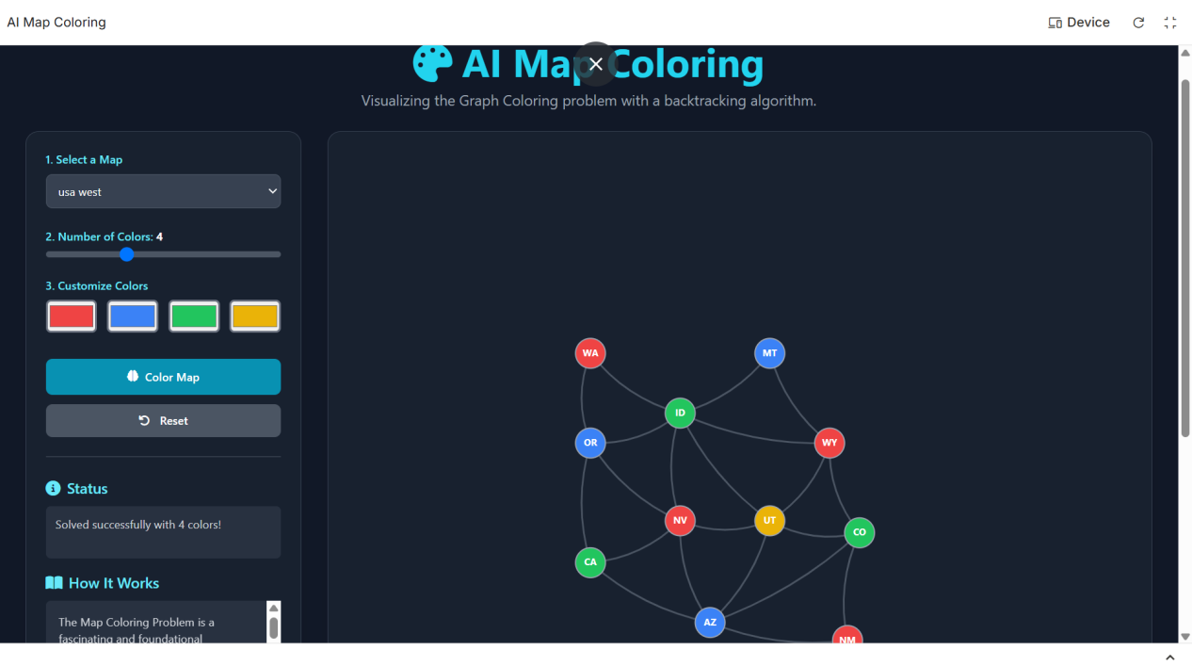
OUTPUT AND RESULTS

Slide 6
OUTPUT AND RESULTS
The application successfully implements and visualizes a backtracking solver for the map coloring problem. It correctly finds valid colorings for various maps and adheres to user-defined constraints like the number of colors. The MRV heuristic proves effective in speeding up the search on more complex graphs. The user interface is intuitive, and the integration of the Gemini API adds significant educational value.

Slide 7
REFERENCES
9.REFERENCE:
Wikipedia: Graph Coloring
Link: https://en.wikipedia.org/wiki/Graph_coloring
GeeksforGeeks: M-Coloring Problem & Backtracking
Link: https://www.geeksforgeeks.org/m-coloring-problem-backtracking-5/
Brilliant.org: Graph Coloring
Link: https://brilliant.org/wiki/graph-coloring/
Tailwind CSS Documentation
Link: https://tailwindcss.com/docs

